Slide 1
Data analysis using MY SQL :- by SUMIT KUMar (6201528165)

Slide 2
INTRODUCTION
This project focuses on building a robust SQL database management system for a second-hand car dealership. The aim is to streamline the dealership’s operations, from tracking vehicle inventory and managing customer details to processing sales and monitoring vehicle servicing. Using SQL, the database will ensure data integrity, optimize queries for better performance, and support efficient data analysis to provide insights into sales trends, popular car models, and customer preferences.
The system is designed to be scalable, allowing the dealership to grow while maintaining a smooth workflow. It will support key business functions, such as managing car details (make, model, year, price, etc.), tracking sales records, and handling customer interactions. Additionally, advanced SQL queries will enable the generation of business reports to help the dealership make informed decisions based on real-time data.
This project not only demonstrates the power of SQL in managing complex datasets but also highlights its importance in supporting business growth and improving operational efficiency.

Slide 3
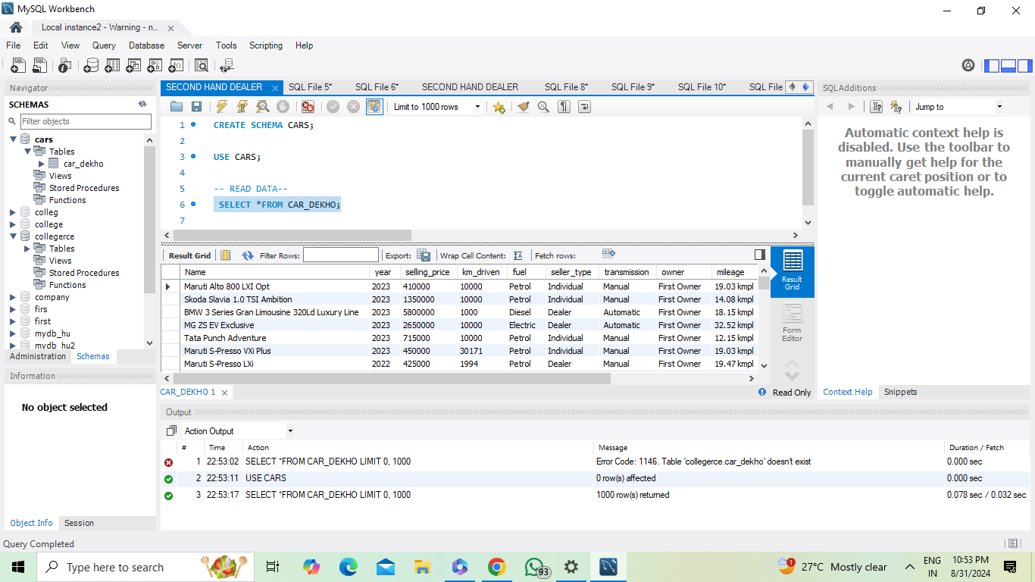
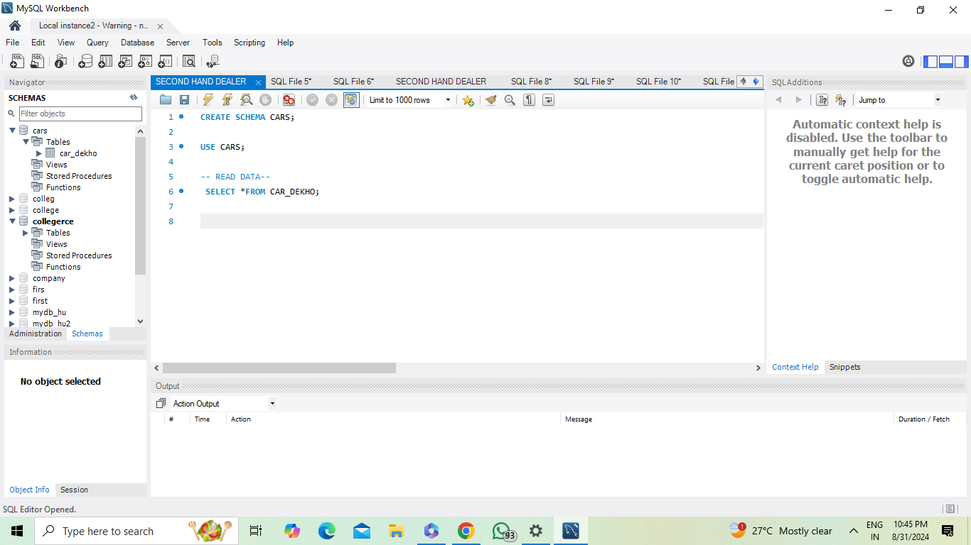
Basic presentation

Slide 4
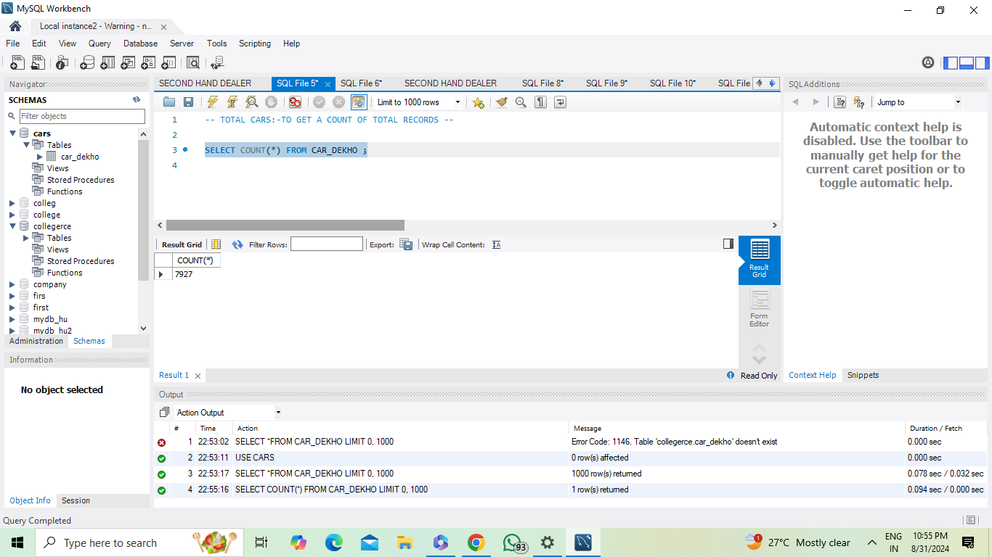

The power of communication

Slide 5
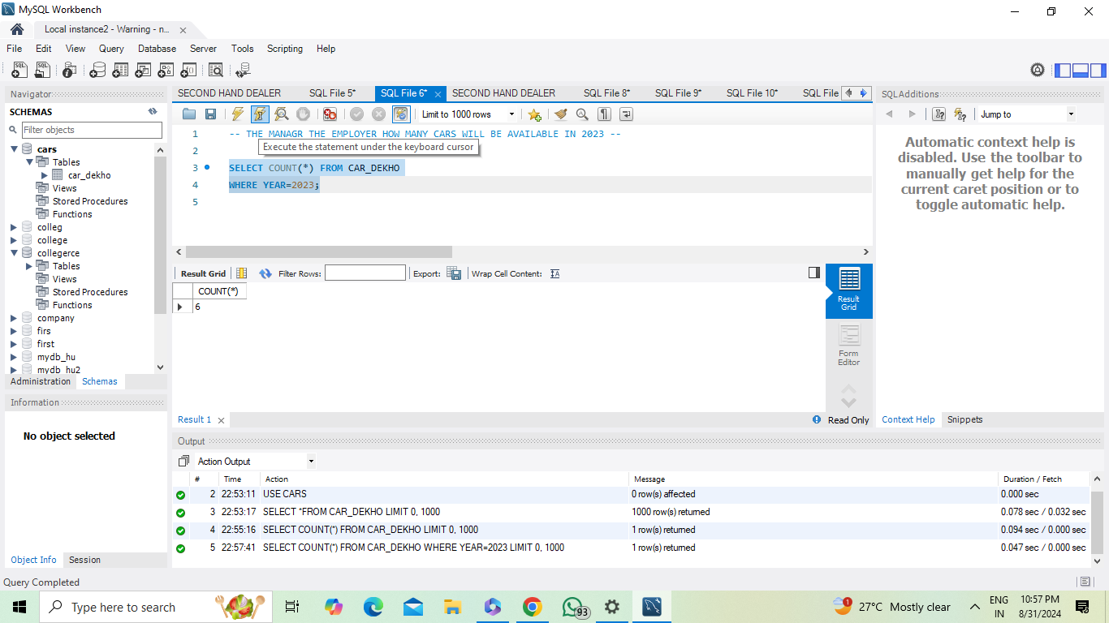

Overcoming nervousness
Confidence-building strategies

Slide 6
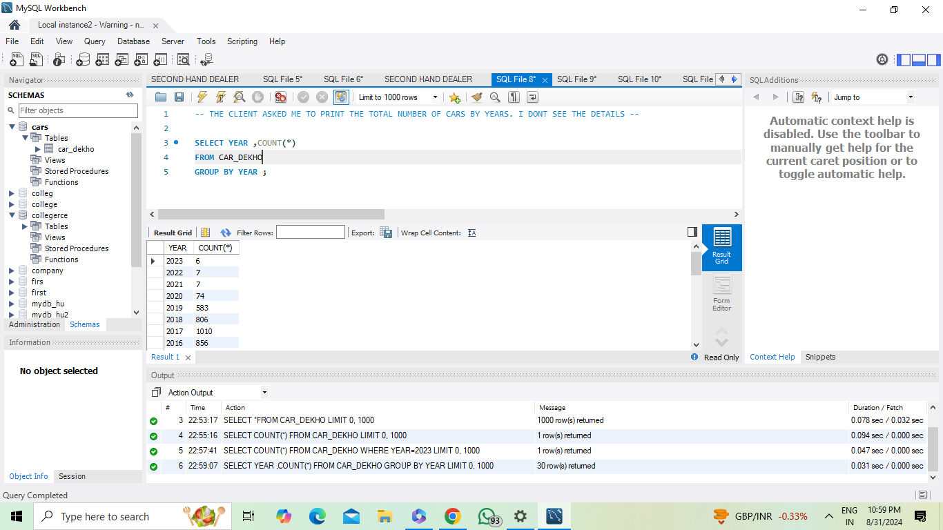
Engaging the audience
Make eye contact with your audience to create a sense of intimacy and involvement
Weave relatable stories into your presentation using narratives that make your message memorable and impactful
Encourage questions and provide thoughtful responses to enhance audience participation
Use live polls or surveys to gather audience opinions, promoting engagement and making sure the audience feel involved

Slide 7
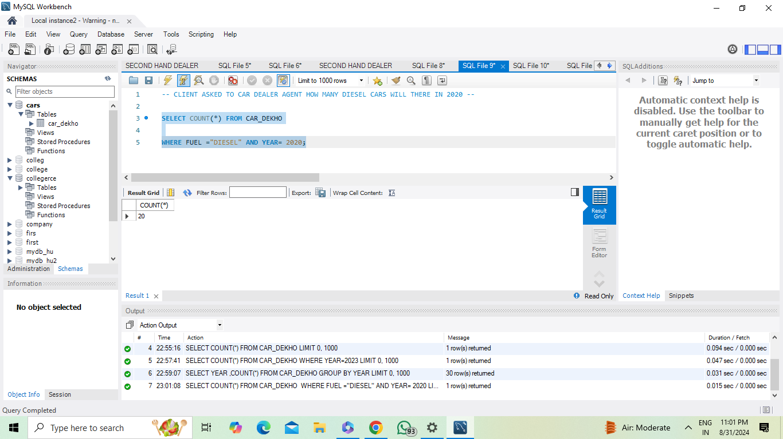
Selecting visual aids
Enhancing your presentation

Slide 8
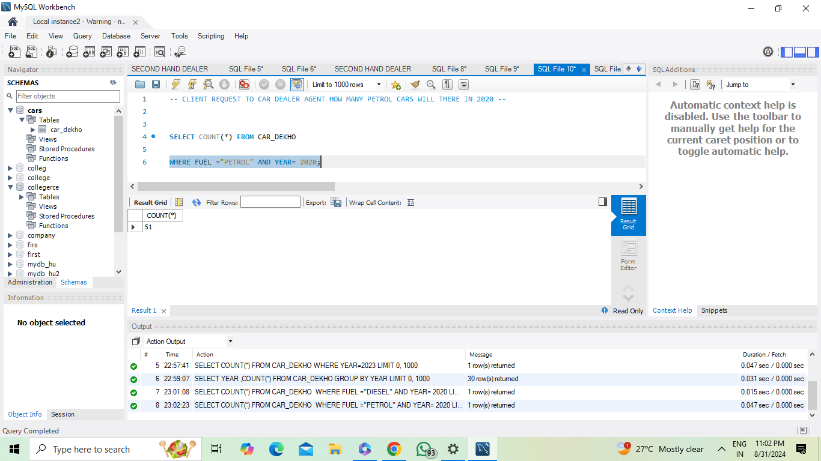
Effective delivery techniques
This is a powerful tool in public speaking. It involves varying pitch, tone, and volume to convey emotion, emphasize points, and maintain interest.
Pitch variation
Tone inflection
Volume control
Effective body language enhances your message, making it more impactful and memorable.
Meaningful eye contact
Purposeful gestures
Maintain good posture
Control your expressions

Slide 9
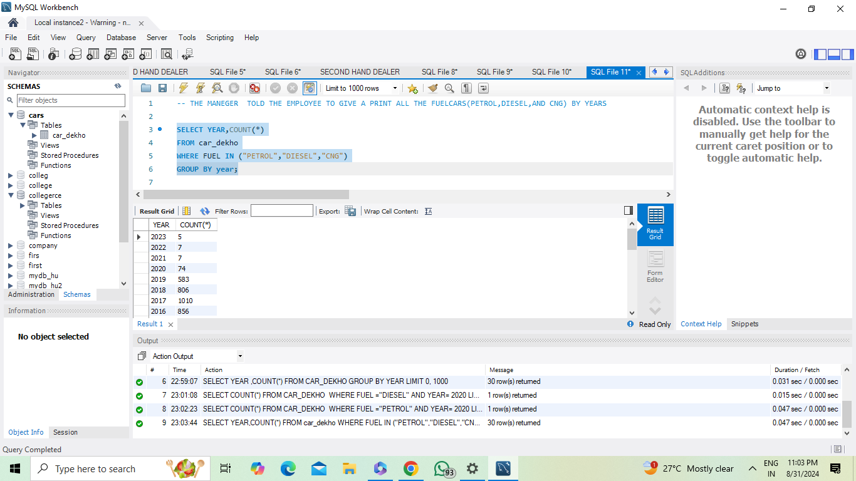

Navigating Q&A sessions
Maintaining composure during the Q&A session is essential for projecting confidence and authority. Consider the following tips for staying composed:
Stay calm
Actively listen
Pause and reflect
Maintain eye contact
Know your material in advance
Anticipate common questions
Rehearse your responses

Slide 10
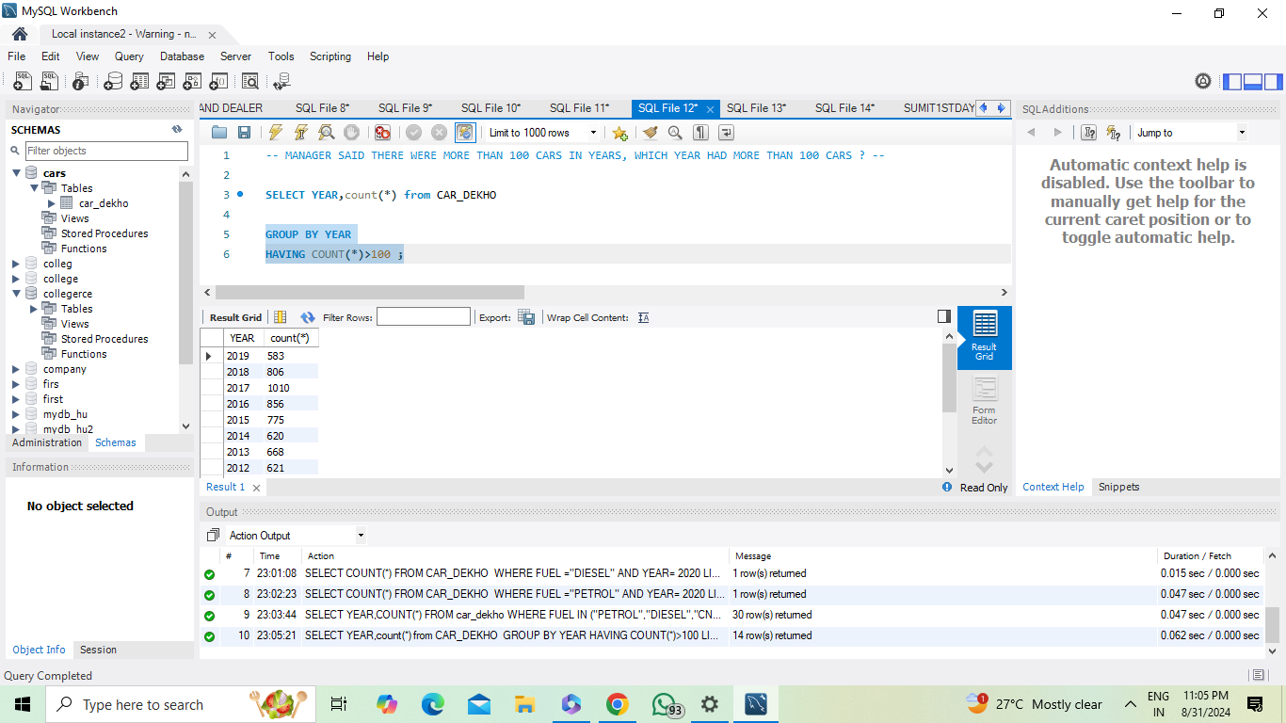

Speaking impact
Your ability to communicate effectively will leave a lasting impact on your audience
Effectively communicating involves not only delivering a message but also resonating with the experiences, values, and emotions of those listening

Slide 11
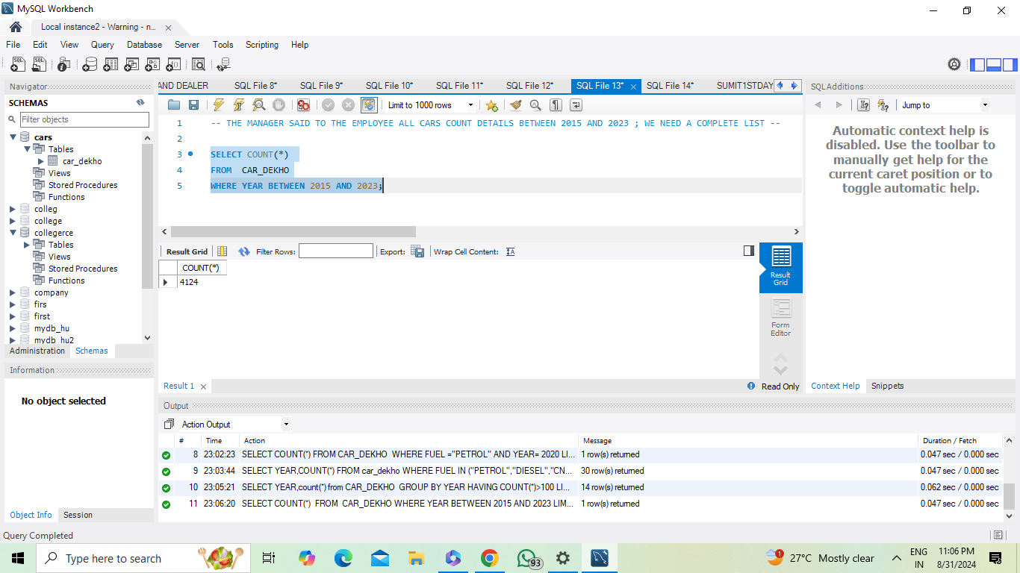
Dynamic delivery
Learn to infuse energy into your delivery to leave a lasting impression
One of the goals of effective communication is to motivate your audience
Metric | Measurement | Target | Actual
Audience attendance | # of attendees | 150 | 120
Engagement duration | Minutes | 60 | 75
Q&A interaction | # of questions | 10 | 15
Positive feedback | Percentage (%) | 90 | 95
Rate of information retention | Percentage (%) | 80 | 85

Slide 12
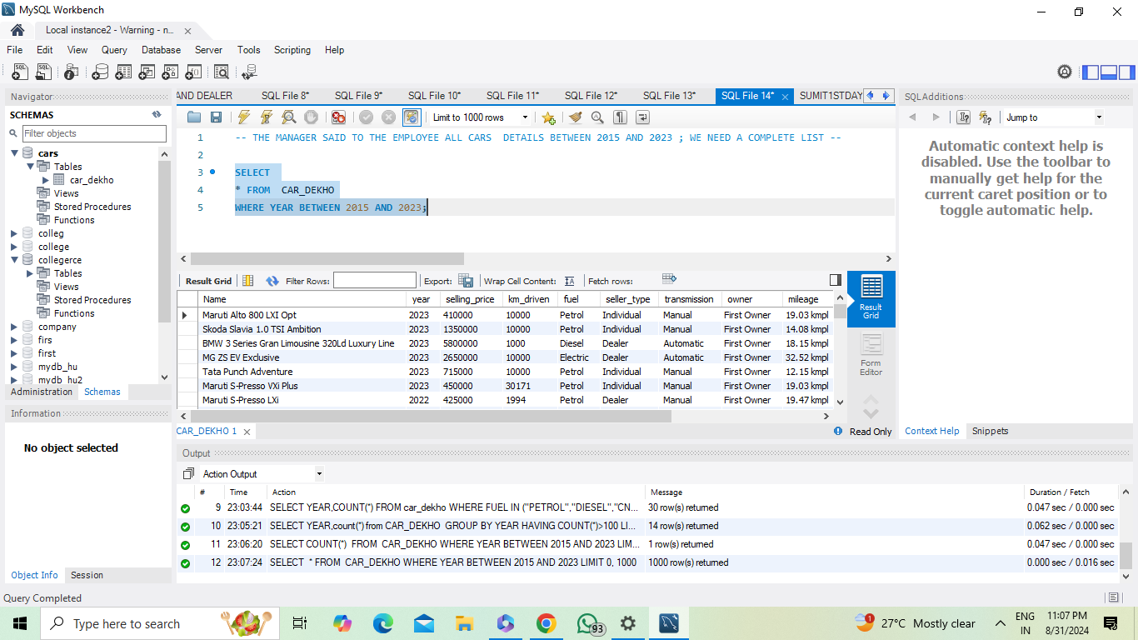
Final tips & takeaways
Consistent rehearsal
Strengthen your familiarity
Refine delivery style
Pacing, tone, and emphasis
Timing and transitions
Aim for seamless, professional delivery
Practice audience
Enlist colleagues to listen & provide feedback
Seek feedback
Reflect on performance
Explore new techniques
Set personal goals
Iterate and adapt

Slide 13
Thank you !
SUMIT KUMAR
620158165
Kumaragarwal65816@gmail.com

